Slide 1
Checking and securing converting improper fractions to mixed numbers
Comparing and ordering fractions and decimals (positive and negative)

Slide 2
how to use Oak lessons

Slide 3
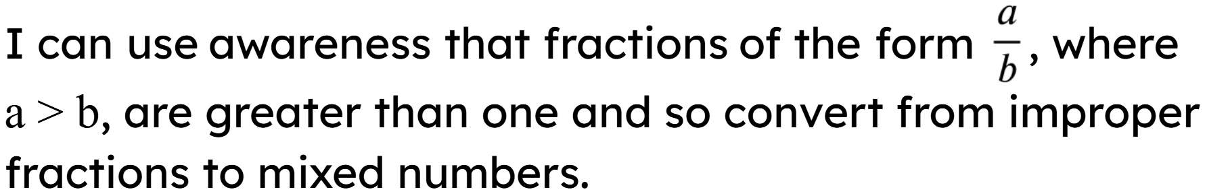

Slide 4



A proper fraction is a fraction where the numerator is less than the denominator.
Example
An improper fraction is a fraction where the numerator is greater than or equal to the denominator.
Example
A mixed number is an improper fraction written as its integer part plus the fractional part, where the fractional part is a proper fraction.
Example

Slide 5

Checking and securing converting improper fractions to mixed numbers
Proper and improper fractions
Changing improper fractions to mixed numbers

Slide 6

Proper and improper fractions
A proper fraction is a fraction where the numerator is less than the denominator.
Fraction
Number line
0
1
A proper fraction is always less than 1

Slide 7
Proper and improper fractions
An improper fraction is a fraction where the numerator is greater than or equal to the denominator.
Fraction
Number line
0
1
An improper fraction is always greater than or equal to 1.

Slide 8
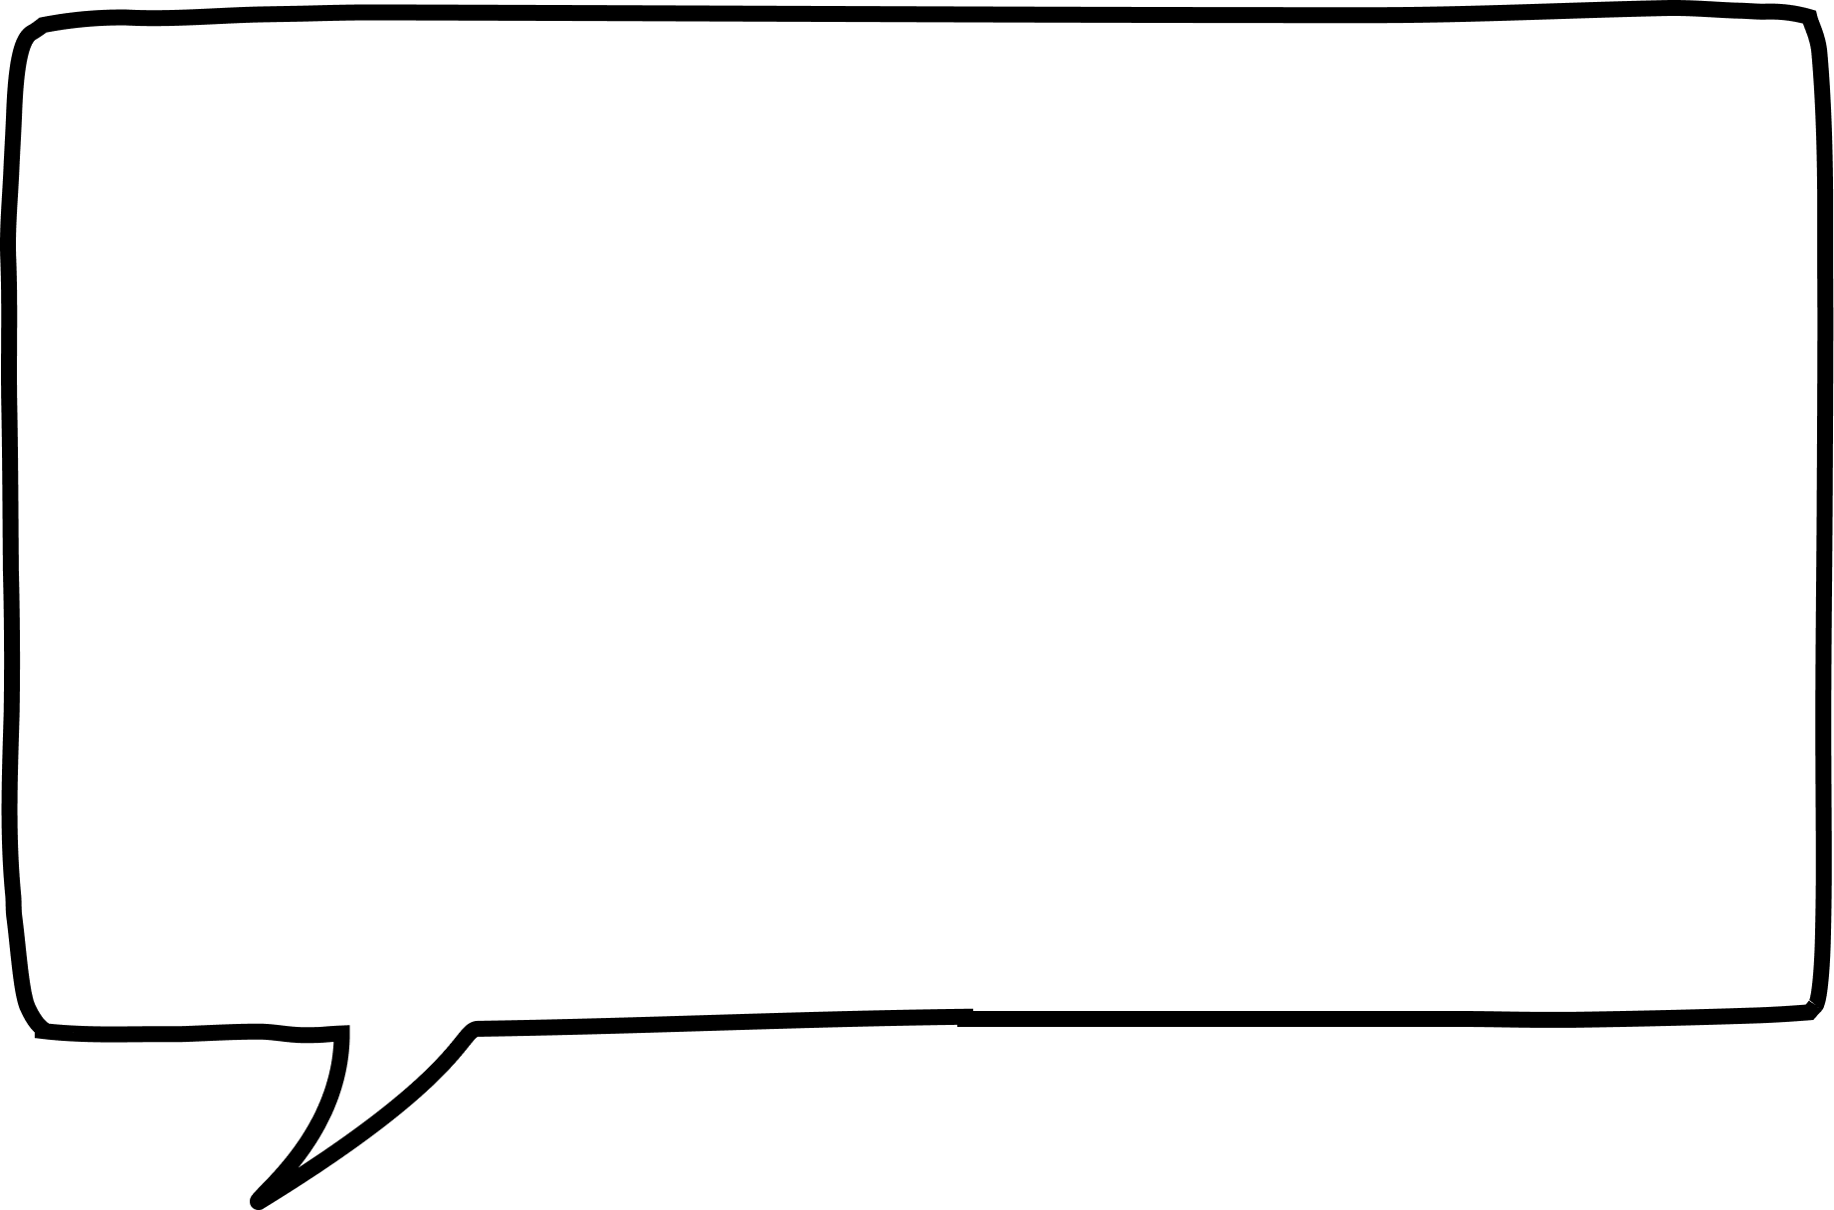
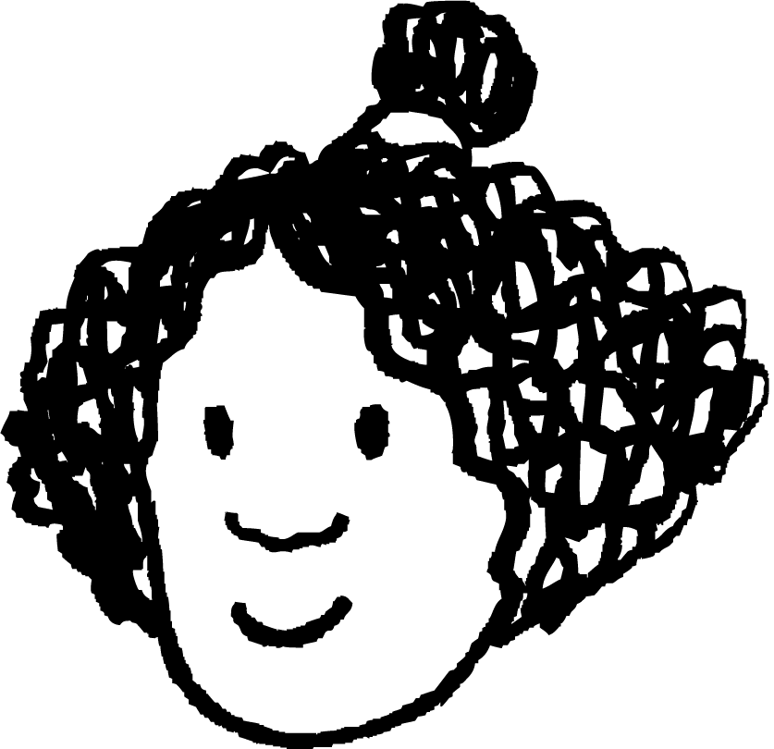
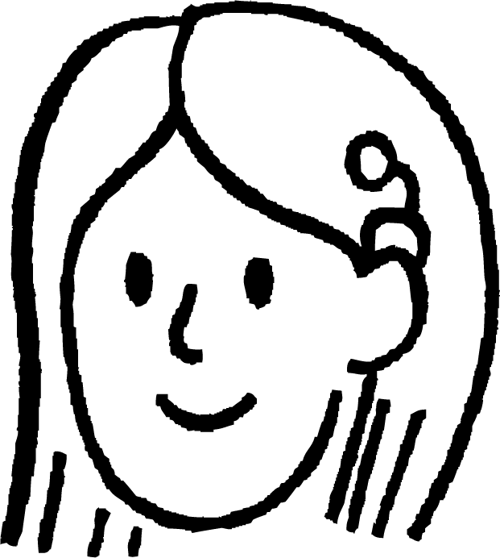

Proper and improper fractions
Andeep has £6 and he is dividing this between his 7 friends.
Each person will get more than £1 each
Each person will get less than £1 each
Izzy
Sofia
Without any working out, explain who is correct using your knowledge on proper and improper fractions.
Sofia is correct. 6 ÷ 7 is the same as . Given the numerator is less than the denominator, the value each student receives will be less than 1.

Slide 9


Proper and improper fractions
0
1
2
3
Mark the position on the number line of:
b)

Slide 10
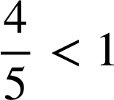

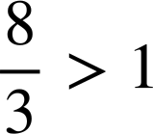
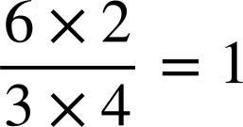
Proper and improper fractions
Insert the inequalities = ,﹥and﹤to make the statement true.
a)
c)
b)
d)

Slide 11
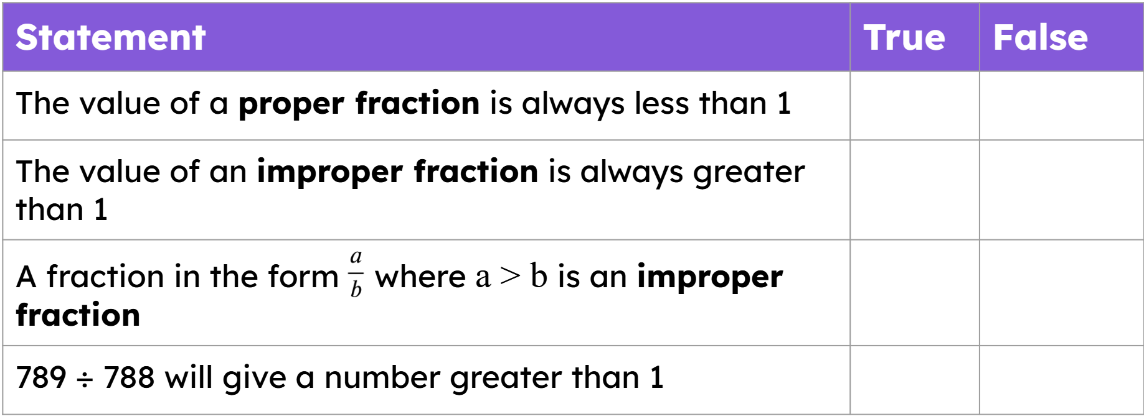
Proper and improper fractions
2) Identify if the following are true or false.
Statement | True | False
The value of a proper fraction is always less than 1
The value of an improper fraction is always greater than 1
A fraction in the form where a > b is an improper fraction
789 ÷ 788 will give a number greater than 1

Slide 12
Proper and improper fractions
3) Without calculating the answer,
which letter corresponds to the calculation
5677 ÷ 5678 is letter
5678 ÷ 5678 is letter
5679 ÷ 5678 is letter
5678 ÷ 2880 is letter
A
B
0
1
2
3
D
C

Slide 13


Proper and improper fractions
4) Here is a section of a number line
Which whole number is the arrow pointing to?
Approximately mark another two whole numbers on the number line. What are these whole numbers?
How would your answers change if the denominator was 6?
What could the denominator be if there were no whole numbers between the two fractions?

Slide 14
Proper and improper fractions
Insert the inequalities = ,﹥and﹤to make the statement true
a)
c)
b)
d)

Slide 15
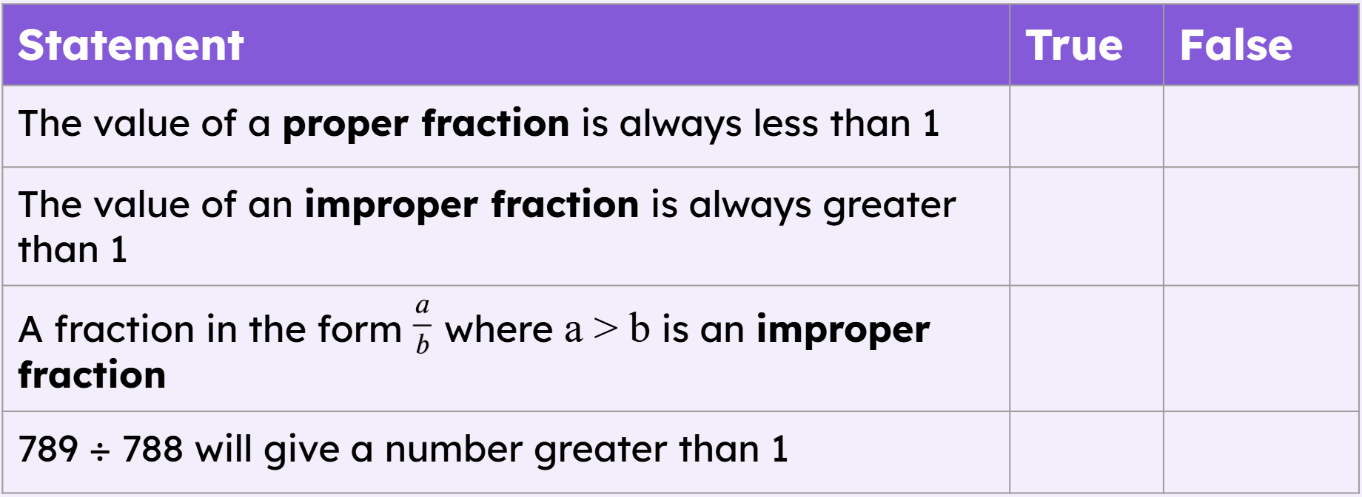

Proper and improper fractions
2) Identify if the following are true or false.
It can equal 1

Slide 16
Proper and improper fractions
3) Without calculating the answer,
which letter corresponds to the calculation
5677 ÷ 5678 is letter
5678 ÷ 5678 is letter
5679 ÷ 5678 is letter
5678 ÷ 2880 is letter
A
B
0
1
2
3
D
C
D
A
C
B

Slide 17
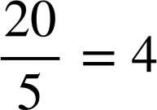
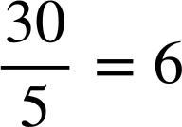
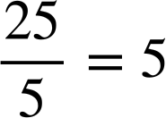
Proper and improper fractions
4) Here is a section of a number line
Which whole number is the arrow pointing to?
Approximately mark another two whole numbers on the number line. What are these whole numbers?

Slide 18
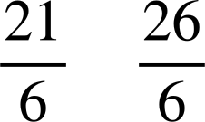
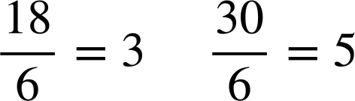
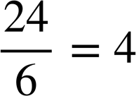
Proper and improper fractions
4) Here is a section of a number line
c) How would your answers change if the denominator was 6?
The answer for part a) would be
The answers for part b) would be and

Slide 19
Proper and improper fractions
4) Here is a section of a number line
d) What could the denominator be if there were no whole numbers between the two fractions?
Any integer which does not have one of its multiples between 21 and 26.

Slide 20


Proper and improper fractions
4) Here is a section of a number line
d) What could the denominator be if there were no whole numbers between the two fractions?
E.g. It could be 7 because the first fraction would be a whole number but there are no more before the second fraction.

Slide 21



Proper and improper fractions
Here is a section of a number line
d) What could the denominator be if there were no whole numbers between the two fractions?
E.g. It couldn’t be 8 as 24 is a multiple of 8, so 3 would lie between the two fractions.

Slide 22




Proper and improper fractions
Here is a section of a number line
d) What could the denominator be if there were no whole numbers between the two fractions?
E.g. It could be 9 because there are no multiples of 9 between 21 and 26.
2 is before the first fraction and 3 is after the second fraction.

Slide 23
Checking and securing converting improper fractions to mixed numbers
Proper and improper fractions
Changing improper fractions to mixed numbers

Slide 24
Changing improper fractions to mixed numbers
A mixed number is an improper fraction written as its integer part plus the fractional part, where the fractional part is a proper fraction.
Example
This means we have 3 whole ones and a half
It is important to recognise the denominator indicates how many equal parts make a whole.

Slide 25

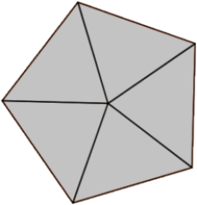
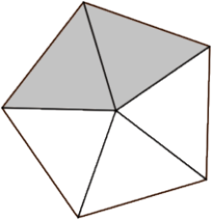
Changing improper fractions to mixed numbers
For example,
Fraction
Example diagram
Number line
0
1
2
3
Each whole one is divided into five equal parts.
The denominator is 5 so we split each whole into 5 equal parts.
If each pentagon
represents 1 whole,
this
shows
shaded.

Slide 26
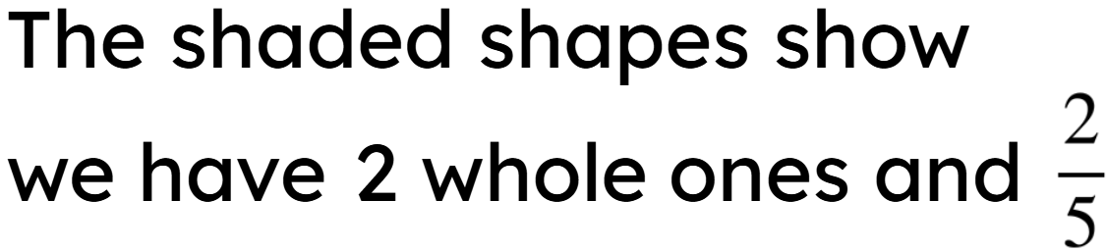
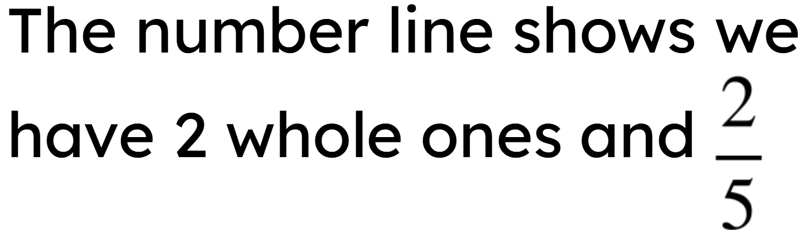

Changing improper fractions to mixed numbers
For example,
Fraction
Example diagram
Number line
0
1
2
3

Slide 27
Changing improper fractions to mixed numbers
For example,
Fraction
How can we identify the mixed number from the improper fraction?
Looking at our denominator, we know five fifths make 1 whole, so we can partition our fraction.

Slide 28
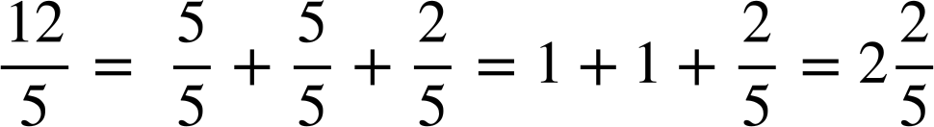
Changing improper fractions to mixed numbers
For example,
Drawing diagrams or number lines are methods to visually represent the mixed number, but using knowledge that the denominator identifies how many parts are a whole is a quicker and easier way.
Fraction

Slide 29
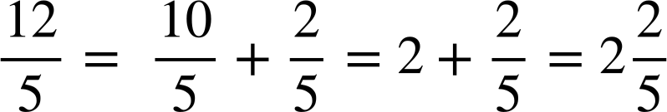
Changing improper fractions to mixed numbers
For example,
Consider multiples of the denominator to make this more efficient.
Fraction

Slide 30
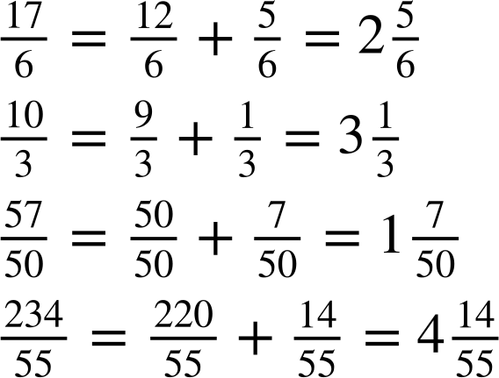
Changing improper fractions to mixed numbers
By filling in the gaps, show the conversion from an improper fraction to a mixed number.
a)
b)
c)
d)

Slide 31
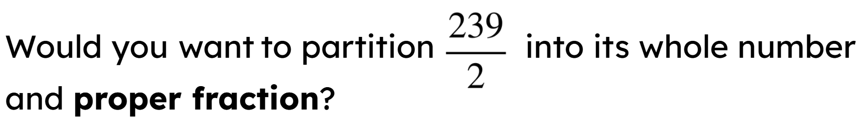
Changing improper fractions to mixed numbers
Partitioning the fraction into wholes and proper fractions is not always the most time efficient method.
So let’s see if we can find a more efficient way.

Slide 32
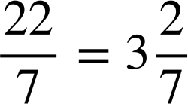

Changing improper fractions to mixed numbers
Improper fractions can be converted to mixed numbers using knowledge on the dividend, quotient, remainder and divisor.
quotient
remainder
dividend
divisor
divisor

Slide 33
Changing improper fractions to mixed numbers
The divisor 7 fits into the dividend 22, 3 whole times. This means the quotient is 3. There is a remainder of 1 which still needs to be divided by the divisor.
quotient
remainder
dividend
divisor
divisor

Slide 34
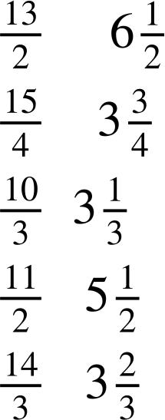

Changing improper fractions to mixed numbers
Match the improper fraction with the correct mixed number.

Slide 35
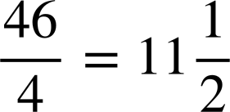
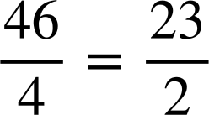
Changing improper fractions to mixed numbers
Jun says
Is he correct? Explain.
Yes he is correct because . This is then converted to

Slide 36
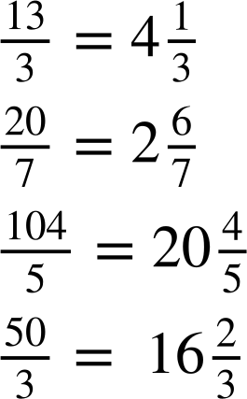
Changing improper fractions to mixed numbers
Write the mixed number of the following improper fractions.
a)
b)
c)
d)

Slide 37
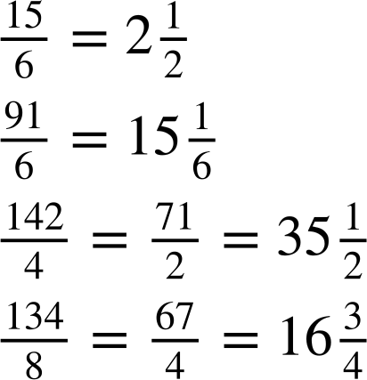
Changing improper fractions to mixed numbers
2) Fill in the blanks.
a)
b)
c)
d)

Slide 38
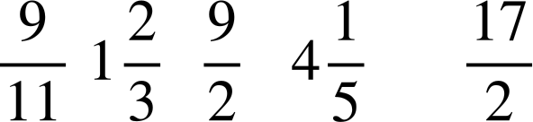
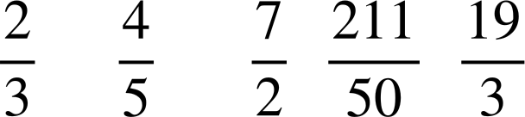
Changing improper fractions to mixed numbers
3) Put the following numbers in ascending order (smallest to largest). Converting to a mixed number may help.
a)
b)

Slide 39
Changing improper fractions to mixed numbers
Write the mixed number of the following improper fractions.
a)
b)
c)
d)

Slide 40
Changing improper fractions to mixed numbers
2) Fill in the blanks.
a)
b)
c)
d)

Slide 41


Changing improper fractions to mixed numbers
3) Put the following numbers in ascending order (smallest to largest). Converting to a mixed number may help.
a)

Slide 42

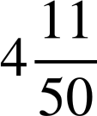
Changing improper fractions to mixed numbers
3) Put the following numbers in ascending order (smallest to largest). Converting to a mixed number may help.
b)

Slide 43
Checking and securing converting improper fractions to mixed numbers
A proper fraction is a fraction where the numerator is less than the denominator. An improper fraction is a fraction where the numerator is greater than or equal to the denominator.
A mixed number is an improper fraction written as its integer part plus the fractional part, where the fractional part is a proper fraction.
mixed number
improper fraction

Slide 44

© Oak National Academy 2023.
Produced in partnership with Mathematics in Education and Industry.
Licensed on the Open Government Licence v3.0, except where otherwise stated. See Oak terms and conditions.

